Slide 1
Algorithms: Greedy Method Activity Selection Problem
Course Code: CSE-2218
Data Structure and Algorithms II Lab
Lec Saifur Rahman
Email: saifur@cse.uiu.ac.bd
Mobile: +8801303529289

Slide 2
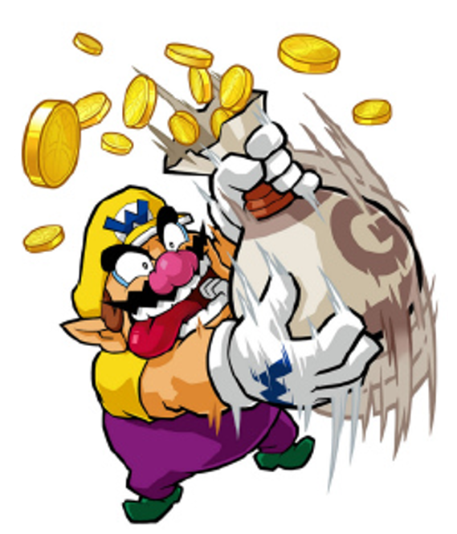
Greedy Algorithms: Principles
A greedy algorithm always makes the choice that looks best at the moment.
A greedy algorithm works in phases. At each phase:
You take the best you can get right now, without regard for future consequences.
Your hope that by choosing a local optimum at each step, you will end up at a global optimum.
For some problems, it works

Slide 3
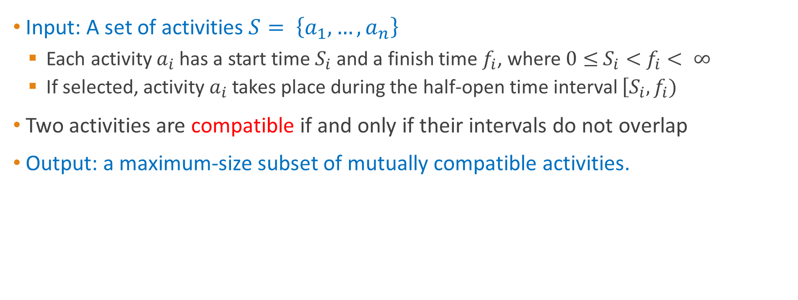
The Activity Selection Problem
Input: A set of activities $S= \left\{a_{1},…, a_{n}\right\}$
Each activity $a_{i}$has a start time $S_{i}$and a finish time $f_{i}$, where $0≤$ $S_{i}<$ $f_{i}< ∞$
If selected, activity $a_{i}$takes place during the half-open time interval $\left[S_{i}, f_{i})\right.$
Two activities are compatible if and only if their intervals do not overlap
Output: a maximum-size subset of mutually compatible activities.

Slide 4
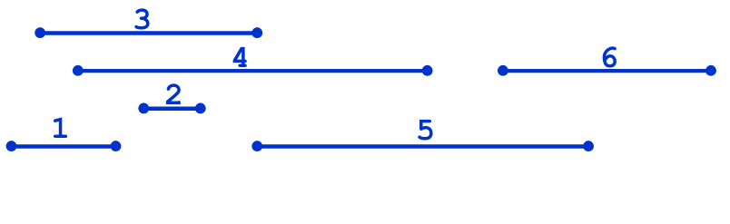

The Activity Selection Problem
Formally:
Given a set S of n activities $s_{i}=$ start time of activity i $f_{i}=$finish time of activity I
Find max-size subset A of compatible activities

Slide 5
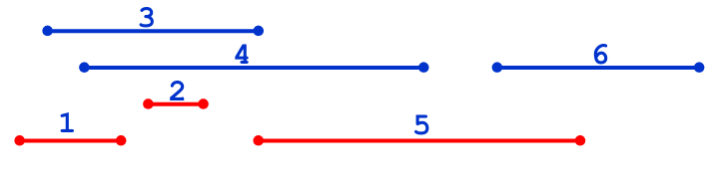

The Activity Selection Problem
Formally:
Given a set S of n activities $s_{i}=$ start time of activity i $f_{i}=$finish time of activity i
Find max-size subset A of compatible activities

Slide 6
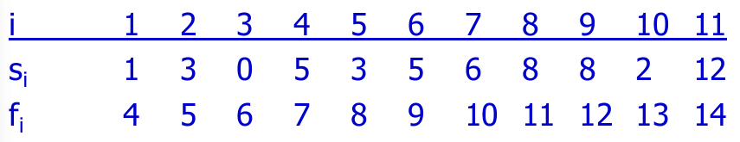
The Activity Selection Problem
Here are a set of start and finish times
What is the maximum number of activities that can be completed?

Slide 7
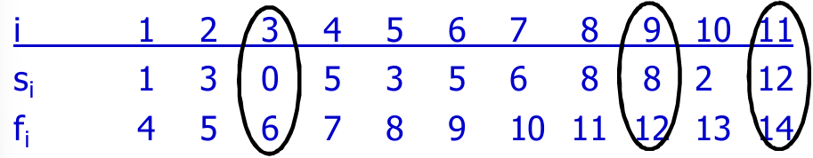

The Activity Selection Problem
Here are a set of start and finish times
What is the maximum number of activities that can be completed?
{$a_{3}, a_{9}, a_{11}$} can be completed

Slide 8
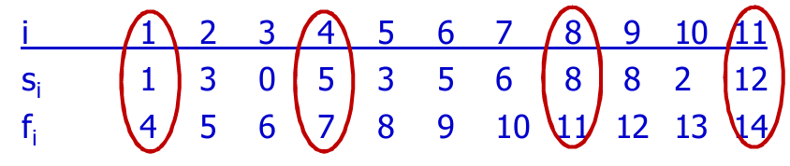

The Activity Selection Problem
Here are a set of start and finish times
What is the maximum number of activities that can be completed?
{$a_{3}, a_{9}, a_{11}$} can be completed
But so can {$a_{1}, a_{4},a_{8},,a_{11}\}$ which is a larger set

Slide 9
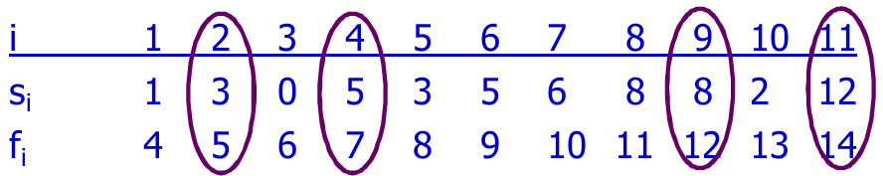
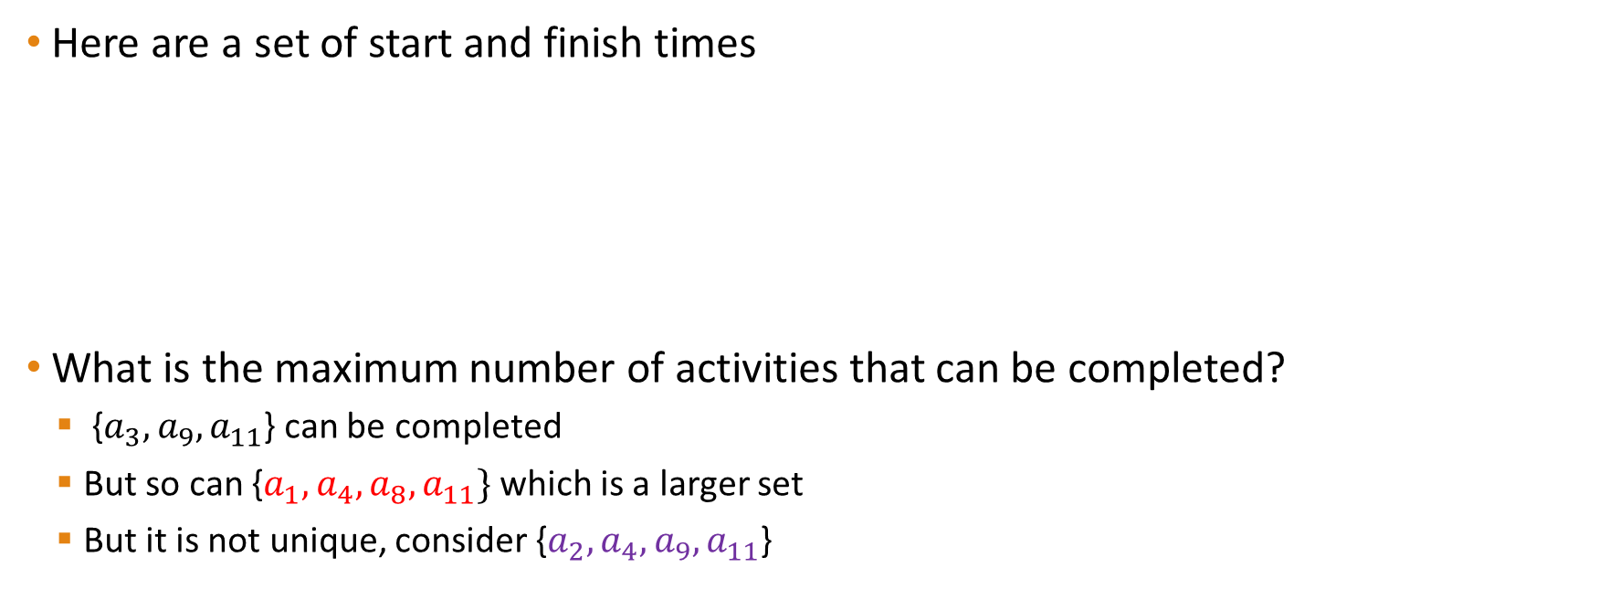
The Activity Selection Problem
Here are a set of start and finish times
What is the maximum number of activities that can be completed?
{$a_{3}, a_{9}, a_{11}$} can be completed
But so can {$a_{1}, a_{4},a_{8},a_{11}\}$ which is a larger set
But it is not unique, consider {$a_{2}, a_{4},a_{9},a_{11}$}

Slide 10
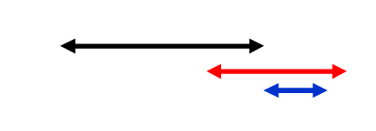
Interval Representation
Here are a set of start and finish times

Slide 11
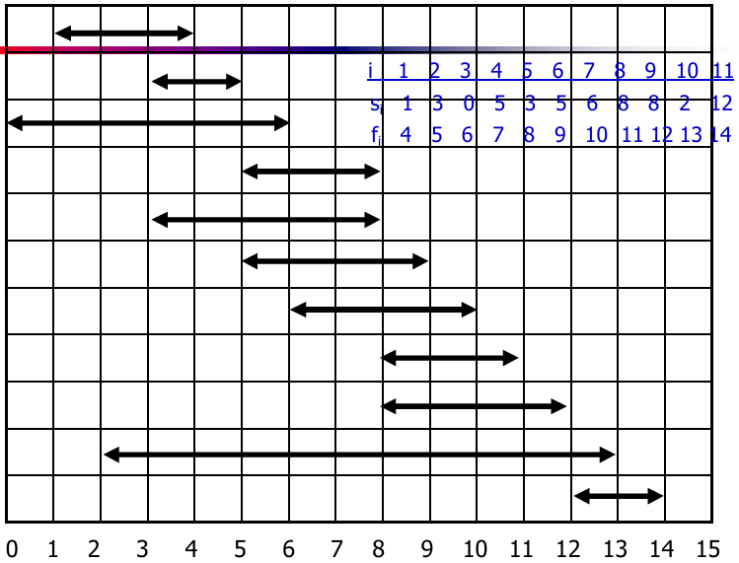

Slide 12
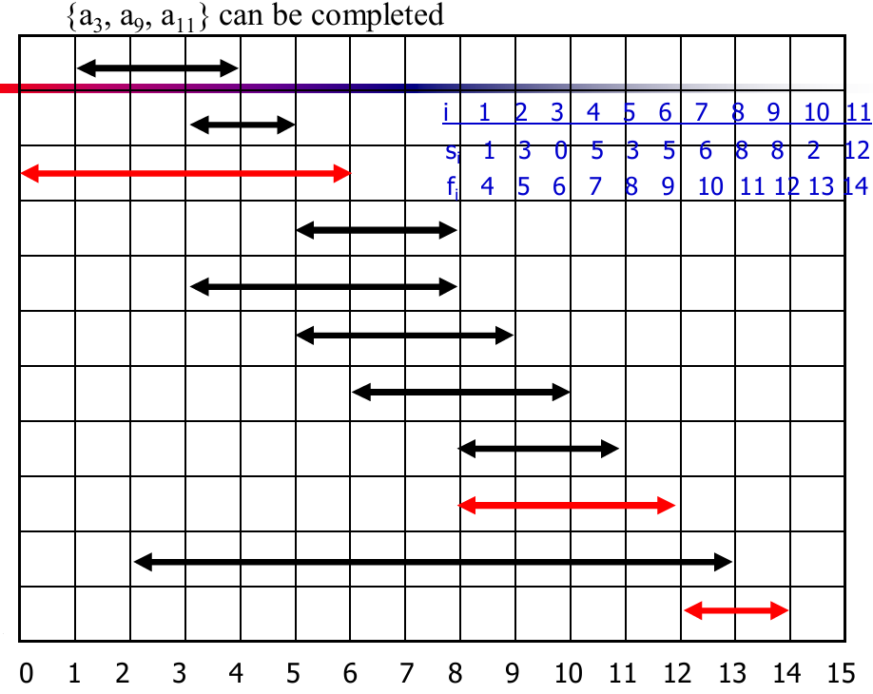

Slide 13
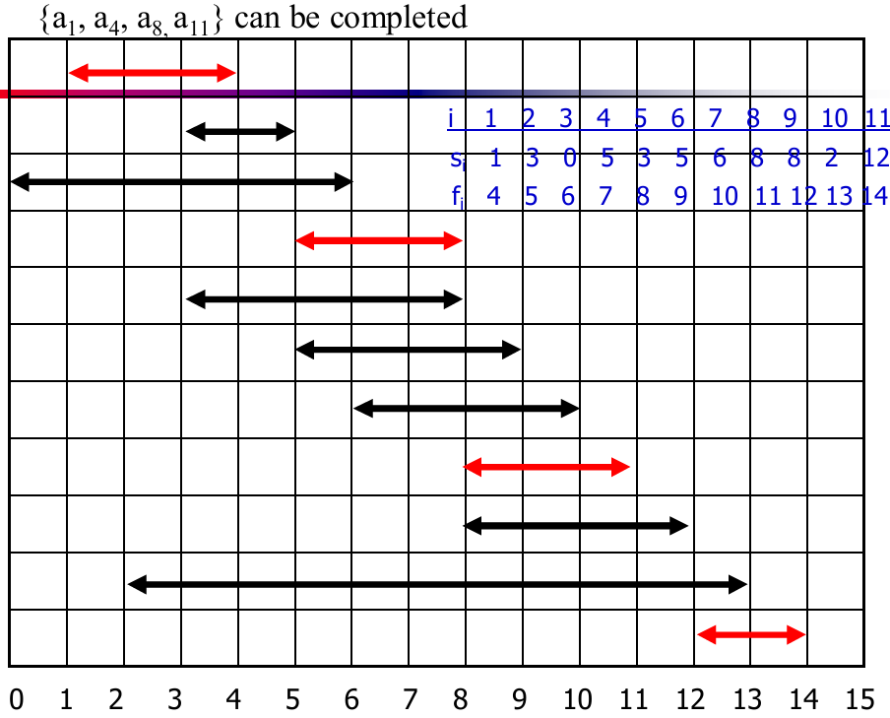

Slide 14
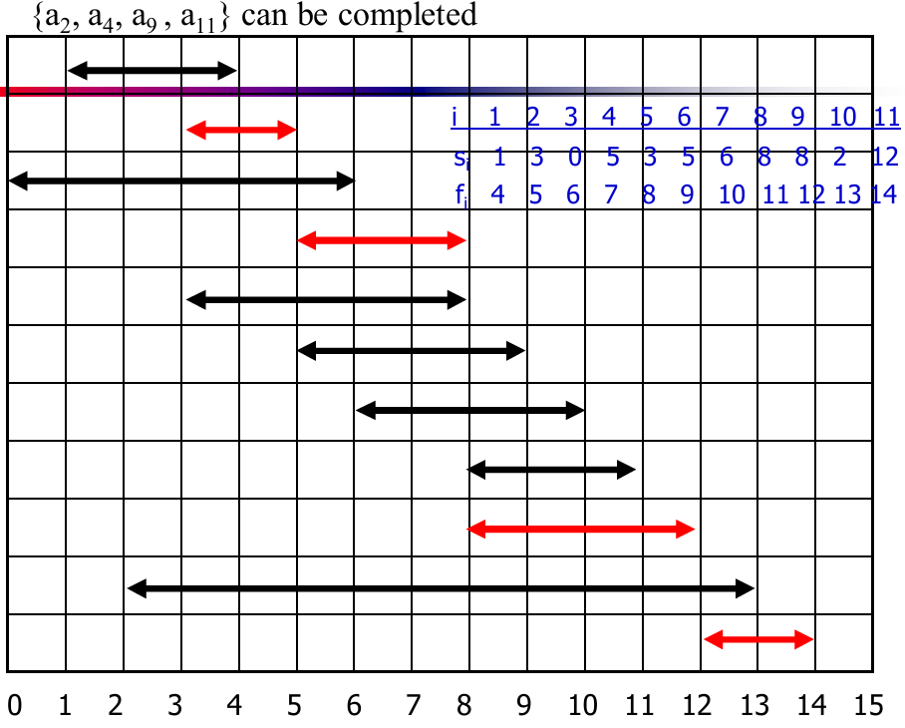

Slide 15

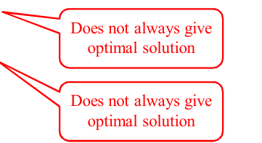
Solving the Activity Selection Problem
The greedy choice can be applied to find solutions (the maximum number of activities that can be performed) by using
Earliest finish time
Earliest start time
Shortest interval

Slide 16
Early Finish Greedy
Select the activity with the earliest finish
Eliminate the activities that could not be scheduled
Repeat!

Slide 17
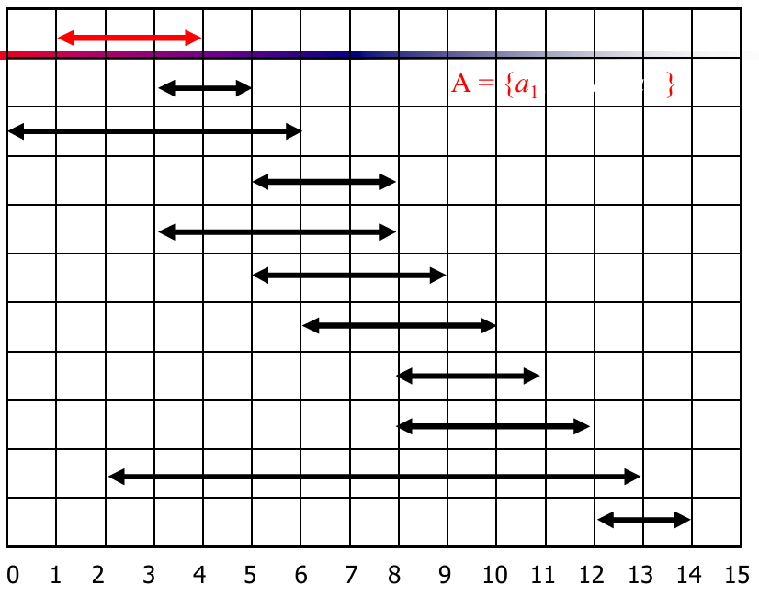

Slide 18
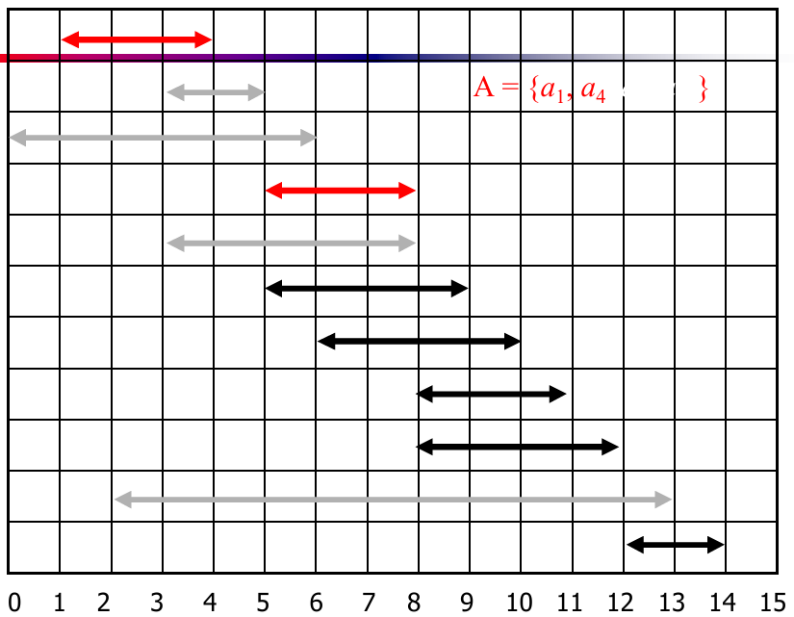

Slide 19
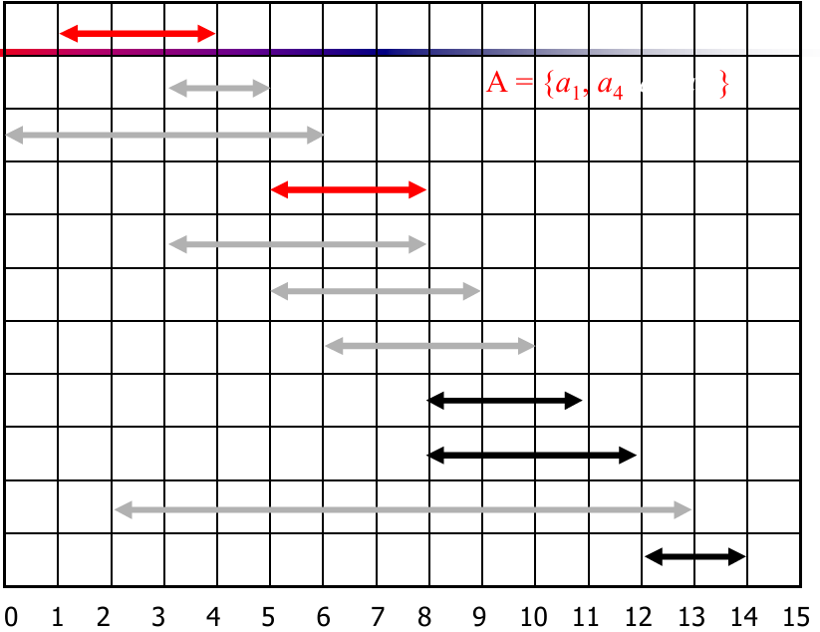

Slide 20
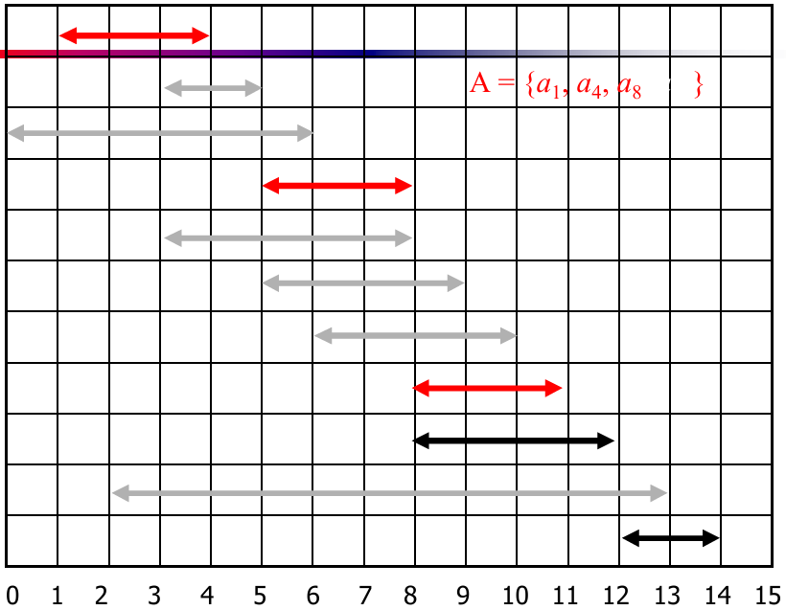

Slide 21
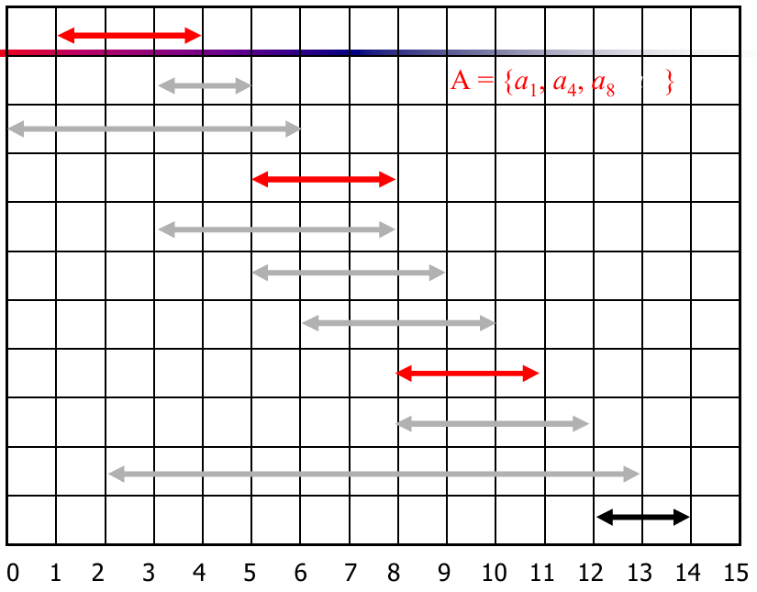

Slide 22
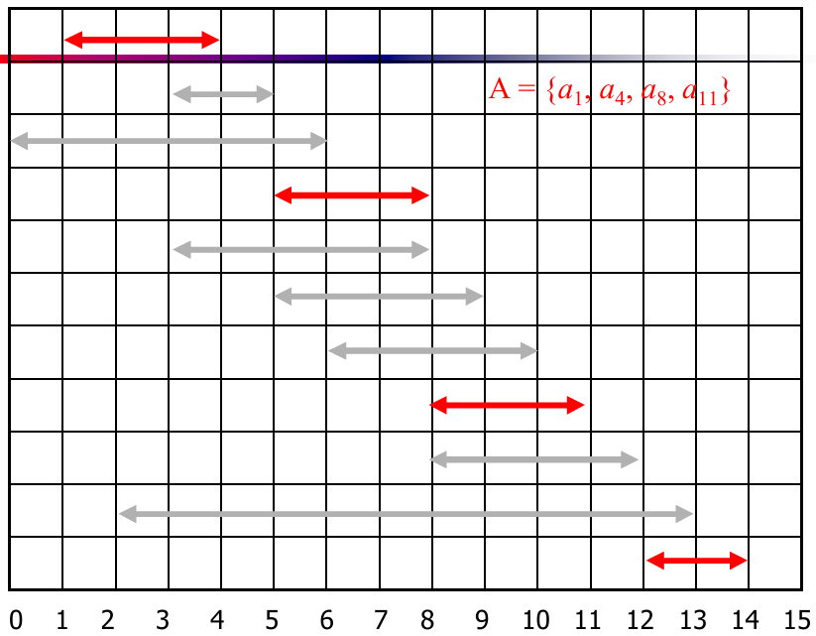

Slide 23
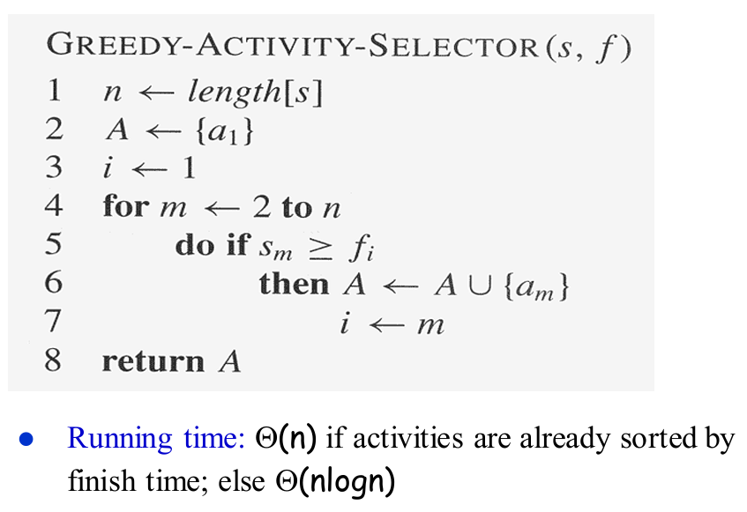
Assuming activities are sorted by finish time

Slide 24
Why is it Greedy?
Greedy in the sense that it leaves as much opportunity as possible for the remaining activities to be scheduled.
The greedy choice is the one that maximizes the amount of unscheduled time remaining.
We will show that this algorithm uses the following properties
The algorithm satisfies the greedy-choice property.
The problem has the optimal substructure property.

Slide 25
Elements of Greedy Strategy
A greedy algorithm makes a sequence of choices, each of the choices that seems best at the moment is chosen
NOT always produces an optimal solution
Two ingredients that are exhibited by most problems that lend themselves to a greedy strategy
Greedy-choice property
Optimal substructure property

Slide 26
Greedy-Choice Property
A globally optimal solution can be arrived at by making a locally optimal (greedy) choice
Make whatever choice seems best at the moment and then solve the sub-problem arising after the choice is made.
The choice made by a greedy algorithm may depend on choices so far, but cannot depend on any future choices or on the solutions to sub-problems
Of course, we must prove that a greedy choice at each step yields a globally optimal solution.

Slide 27
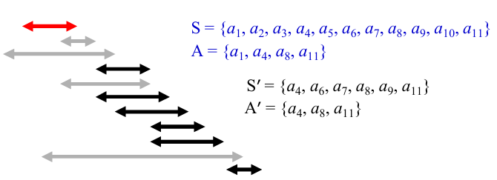

Optimal Substructure Property
A problem exhibits optimal substructure if an optimal solution to the problem contains within it optimal solutions to sub-problems.
If an optimal solution A to S begins with activity 1, then A’ = A – {1} is optimal to S’ = {i ∈ S: $s_{i} ≥f_{1}$}

Slide 28
Variations of the Activity Selection Problem
While we’ve covered the basic Activity Selection Problem, there are several interesting variations you might encounter:
Weighted Activity Selection:
In this variation, each activity has a weight or value associated with it. The goal is to select activities that maximize the total value rather than just the number of activities.
Activity Selection with Multiple Resources:
In this variation, you have multiple resources (e.g., multiple conference rooms) and you want to schedule as many activities as possible across all resources.

